Slide 1

Select Topics in Python Creating and Using Dictionaries
Notes:
‹#›

Slide 2

Objectives
Objectives
Introduction to dictionaries in Python.
Initializing dictionaries.
Manipulating dictionaries.
Using a list or dictionary for a program.
Notes:
‹#›

Slide 3
Introduction to Dictionaries
A dictionary
is a set of 'keys' (words)
all pointing to their own 'values' (meanings).
dict1 = {"first_name" : ”Mike", "last_name" : ”Smith"}
Dictionary name
Key 1
String
Value 1
String
Key 2
String
Value 2
String
dict1['John'] = 'Leo'
Dictionary name
Key 1
String
Value 1
String
Notes:
A dictionary organizes information by association, not position
Example: When you use a dictionary to look up the definition of “mammal,” you don’t start at page 1; instead, you turn directly to the words beginning with “M”
Data structures organized by association, they are also called tables or association lists
In Python, a dictionary associates a set of keys with data values
Keys can be data of any immutable types
Including other data structures
You can think of a dictionary as an unordered set of key: value pairs, with the requirement that the keys are unique (within one dictionary)
‹#›

Slide 4
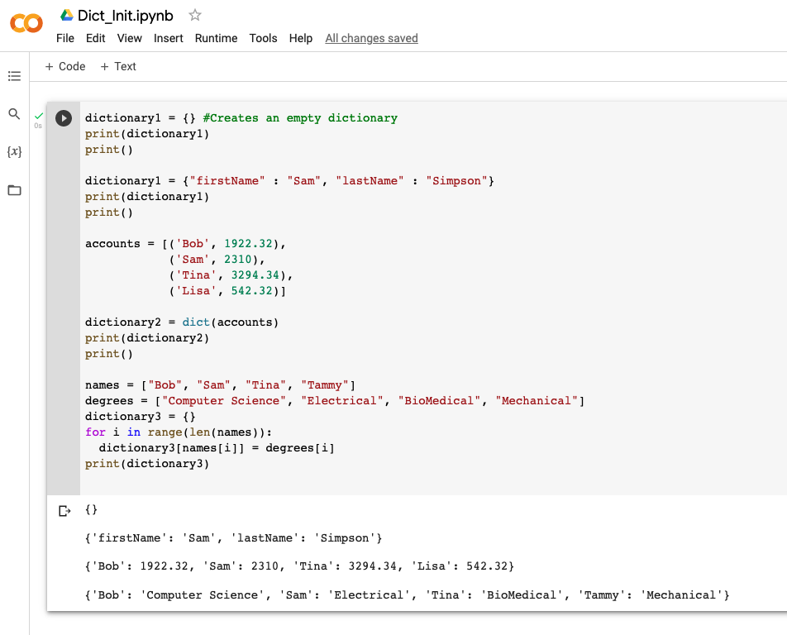
Initialize Dictionaries
Create Dictionary
Create a default.
Use a list of key and pair values.
Make a parallel list.
dictionary3 = zip(names, degrees)
Notes:
Rather than using a for loop, there is a built-in function that can put parallel lists together (either into a tuple or dictionary)
zip is a built-in function that takes two or more sequences and “zips” them into a list of tuples, where each tuple contains one element from each sequence
‹#›

Slide 5
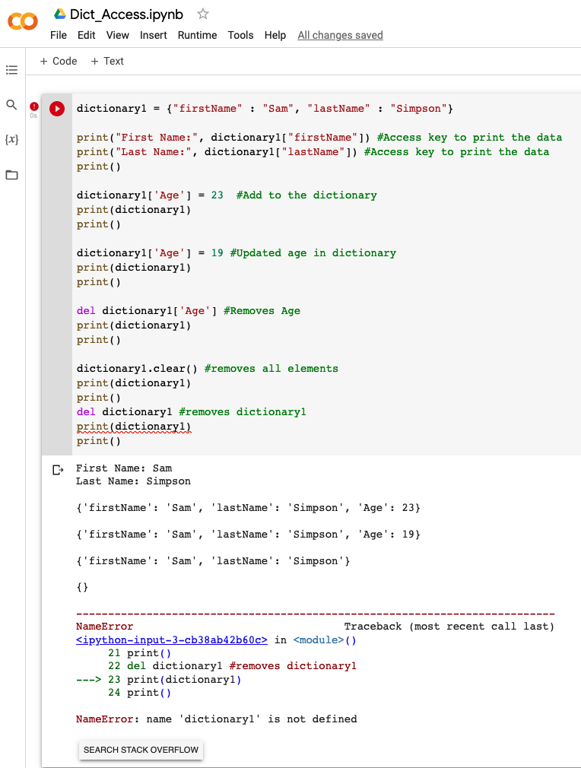
Dictionary Operations
Dictionary
Access values.
Update.
Delete.

Slide 6
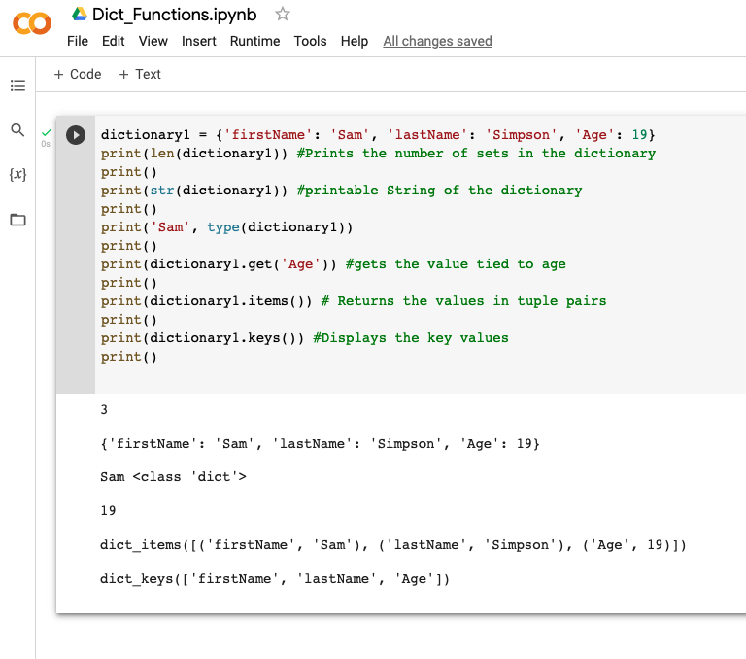
Dictionary Functions and Methods
Functions and methods
len(dictionary)
str(dictionary)
type(var)
dictionary.clear()
dictionary.deepcopy()
dictionary.get(key,default=None)
dictionary.items()
dictionary.values()
dictionary.keys()
dictionary.update(dictionary2)
dictionary.setdefault(key, default=None)
Notes:
len(dict)
Gives the total length of the dictionary. This would be equal to the number of items in the dictionary.
str(dict)
Produces a printable string representation of a dictionary
type(variable)
Returns the type of the passed variable. If passed variable is dictionary, then it would return a dictionary type.
dict.clear()
Removes all elements of dictionary dict
dict.deepcopy()
Returns a deep copy of dictionary dict
dict.fromkeys(seq, value=None)
Create a new dictionary with keys from seq and values set to value.
dict.get(key, default=None)
For key key, returns value or default if key not in dictionary
dict.items()
Returns a list of dict's (key, value) tuple pairs
dict.values()
Returns a list of dictionary dict's values
dict.keys()
Returns a list of dictionary dict's keys
dict.setdefault(key, default=None)
Similar to get(), but will set dict[key]=default if key is not already in dict
dict.update(dict2)
Adds dictionary dict2's key-values pairs to dict
‹#›

Slide 7
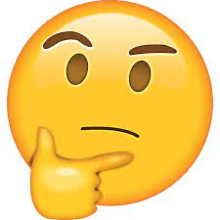
Using a List or Dictionary for a program
When to use a dictionary?
You don't need things to be in order.
You can add and remove elements and their keys.
If you need it in order, you have to use a list for that.
Notes:
Hope this gives you a basic understanding of how Dictionaries can be used to store your data. See you in the next video.

